Slide 1
TELLING YOUR STORY WITH DATA
January 2026 NCDA Conference

Slide 2
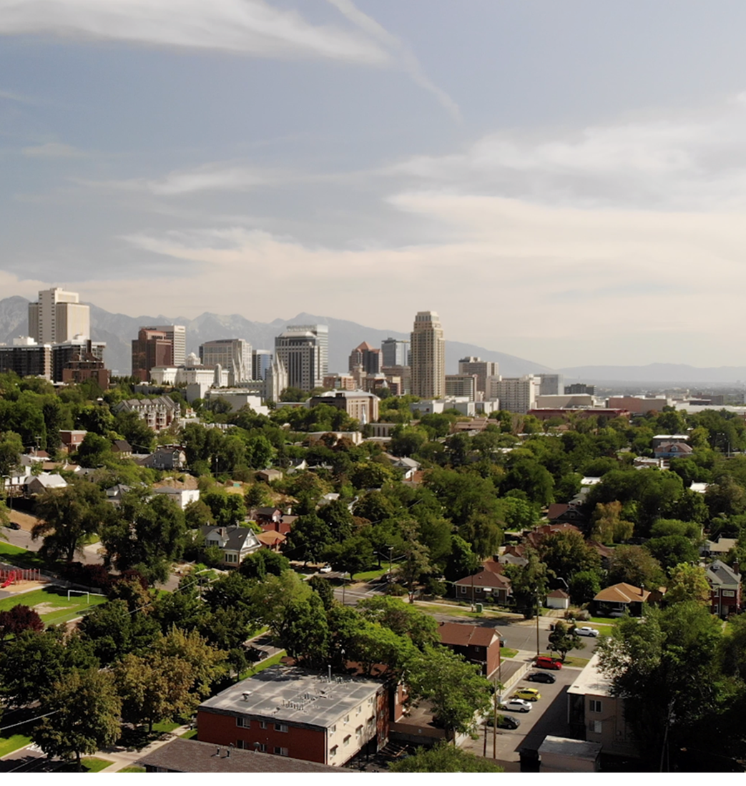

SALT LAKE CITY
Population | 209,592
Metro Population | 1,257,936
Our Team
Housing Stability Division | 26 staff
Community Development Team | 8 staff
HUD Funding (2025)
CDBG - $4.8M
HOME - $1.6M
HOPWA - $972K
ESG - $293K
City Funding (2026)
FOF - $2.4M
General Fund - $3.0M

Slide 3

AGENDA
1) Political Strategy
Prep Work
Timing
People
Winning
2) How to Talk to Legislators
3) Handout & Dashboard Examples

Slide 4
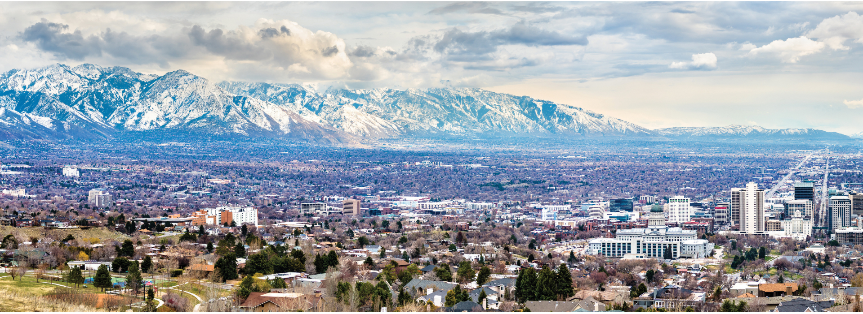
POLITICAL STRATEGY

Slide 5
PREPARE IN ADVANCE GET THE TIMING RIGHT TALK TO THE RIGHT PEOPLE CELEBRATE YOUR WINS

Slide 6



DO YOUR HOMEWORK
Research
Regulations
Recommendations

Slide 7

PREPARE YOUR MESSAGING
The message is not for you, it’s for your audience.
Know their ideology.
Find what you both agree on and start there.

Slide 8




KNOW YOUR LEGISLATOR
Campaign Website
Newsletters
Social Media
Sponsored Bills

Slide 9
PREPARE IN ADVANCE GET THE TIMING RIGHT TALK TO THE RIGHT PEOPLE CELEBRATE YOUR WINS

Slide 10



PUBLIC PRESSURE MOVES POLICY
Crisis, Scandal
Media Attention
Protests, Petitions

Slide 11


POLITICAL LEADERSHIP
Elections
New Initiatives

Slide 12

PROCEDURAL STEPS
Pre-Legislative Session
Committee Votes
Floor Votes
Transfer Between Chambers
Signing Into Law

Slide 13
PREPARE IN ADVANCE GET THE TIMING RIGHT TALK TO THE RIGHT PEOPLE CELEBRATE YOUR WINS

Slide 14



WHO REPRESENTS YOU?
Local Elected Officials
State Representative & Senator
Federal Representative & Senators

Slide 15

GATEKEEPERS
Issue Leaders
Bill Sponsors
Committee Members
House and Senate Leadership

Slide 16
PREPARE IN ADVANCE GET THE TIMING RIGHT TALK TO THE RIGHT PEOPLE CELEBRATE YOUR WINS

Slide 17



GIVE YOUR LEGISLATOR A WIN
Social Media
Email Reports
Press Events & Photo Ops
Award Ceremonies

Slide 18
PREPARE IN ADVANCE GET THE TIMING RIGHT TALK TO THE RIGHT PEOPLE CELEBRATE YOUR WINS

Slide 19
MEET YOUR LEGISLATORS

Slide 20

IT’S OKAY, THIS IS NORMAL
It is normal to meet with staff
It is normal to only have 15 min
It is normal to have last-minute changes to the location or time

Slide 21


GUIDE THE CONVERSATION
Keep it to 1 Page
Optional: Backup Packet
Don’t Touch the Third Rails

Slide 22

KEEP YOUR TIME LIMIT
They can go over time. You cannot.
1/3 Presentation
2/3 Questions

Slide 23


PAY ATTENTION
Body Language
Facial Expressions
Note Taking

Slide 24



DO SOMETHING FOR THEM
Constituent Service
Fulfill a Core Value
Give them a Win

Slide 25

END WITH AN ASK
Actionable
Specific
Reasonable

Slide 26



FOLLOW UP
Business Card
Email
Digital Copies

Slide 27
GUIDE THE CONVERSATION KEEP YOUR TIME LIMIT PAY ATTENTION DO SOMETHING FOR THEM END WITH AN ASK FOLLOW UP

Slide 28
HANDOUTS & DASHBAORDS

Slide 29


KEEP IT SIMPLE
3s Are Your Friend
Define Terms
Data + Stories
Icons + Numbers
3

Slide 30


MAKE IT NICE
Use Cardstock
60-30-10 Rule
No Stock Photos

Slide 31
HANDOUT

Slide 32
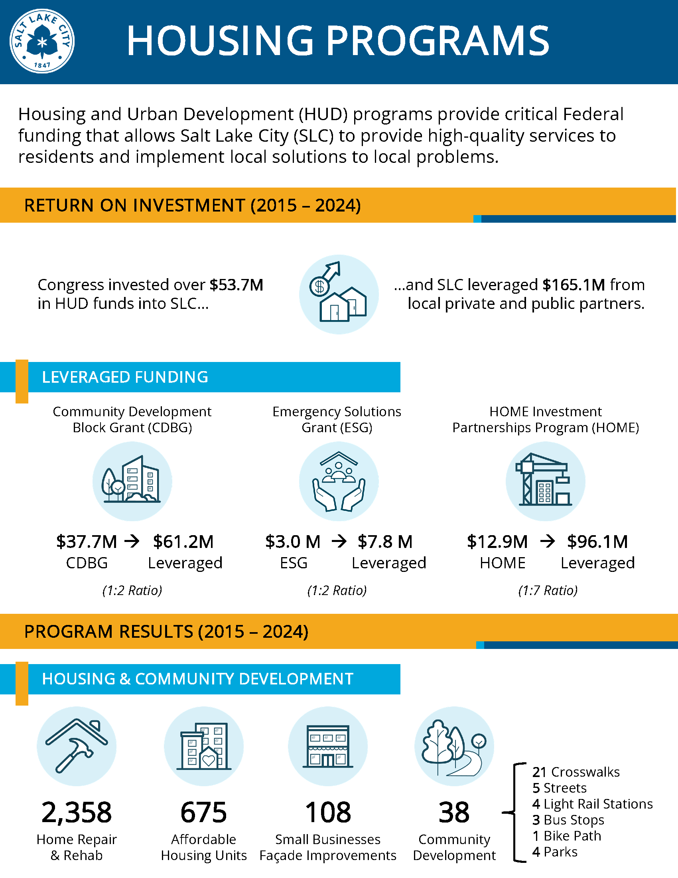

Slide 33
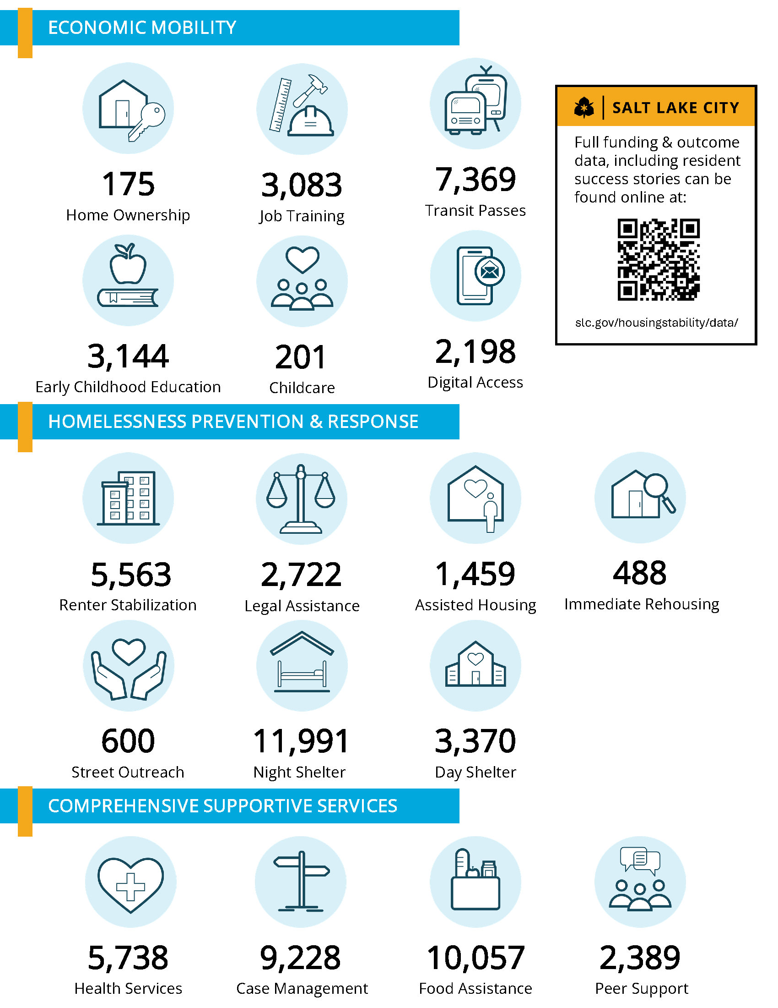

Slide 34
DASHBOARD

Slide 35
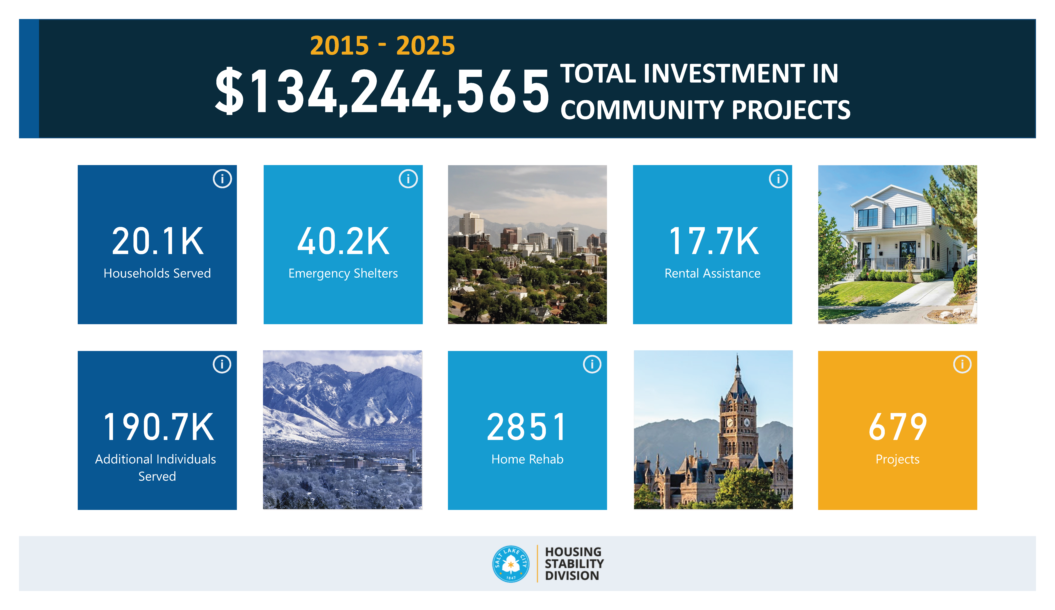

Slide 36
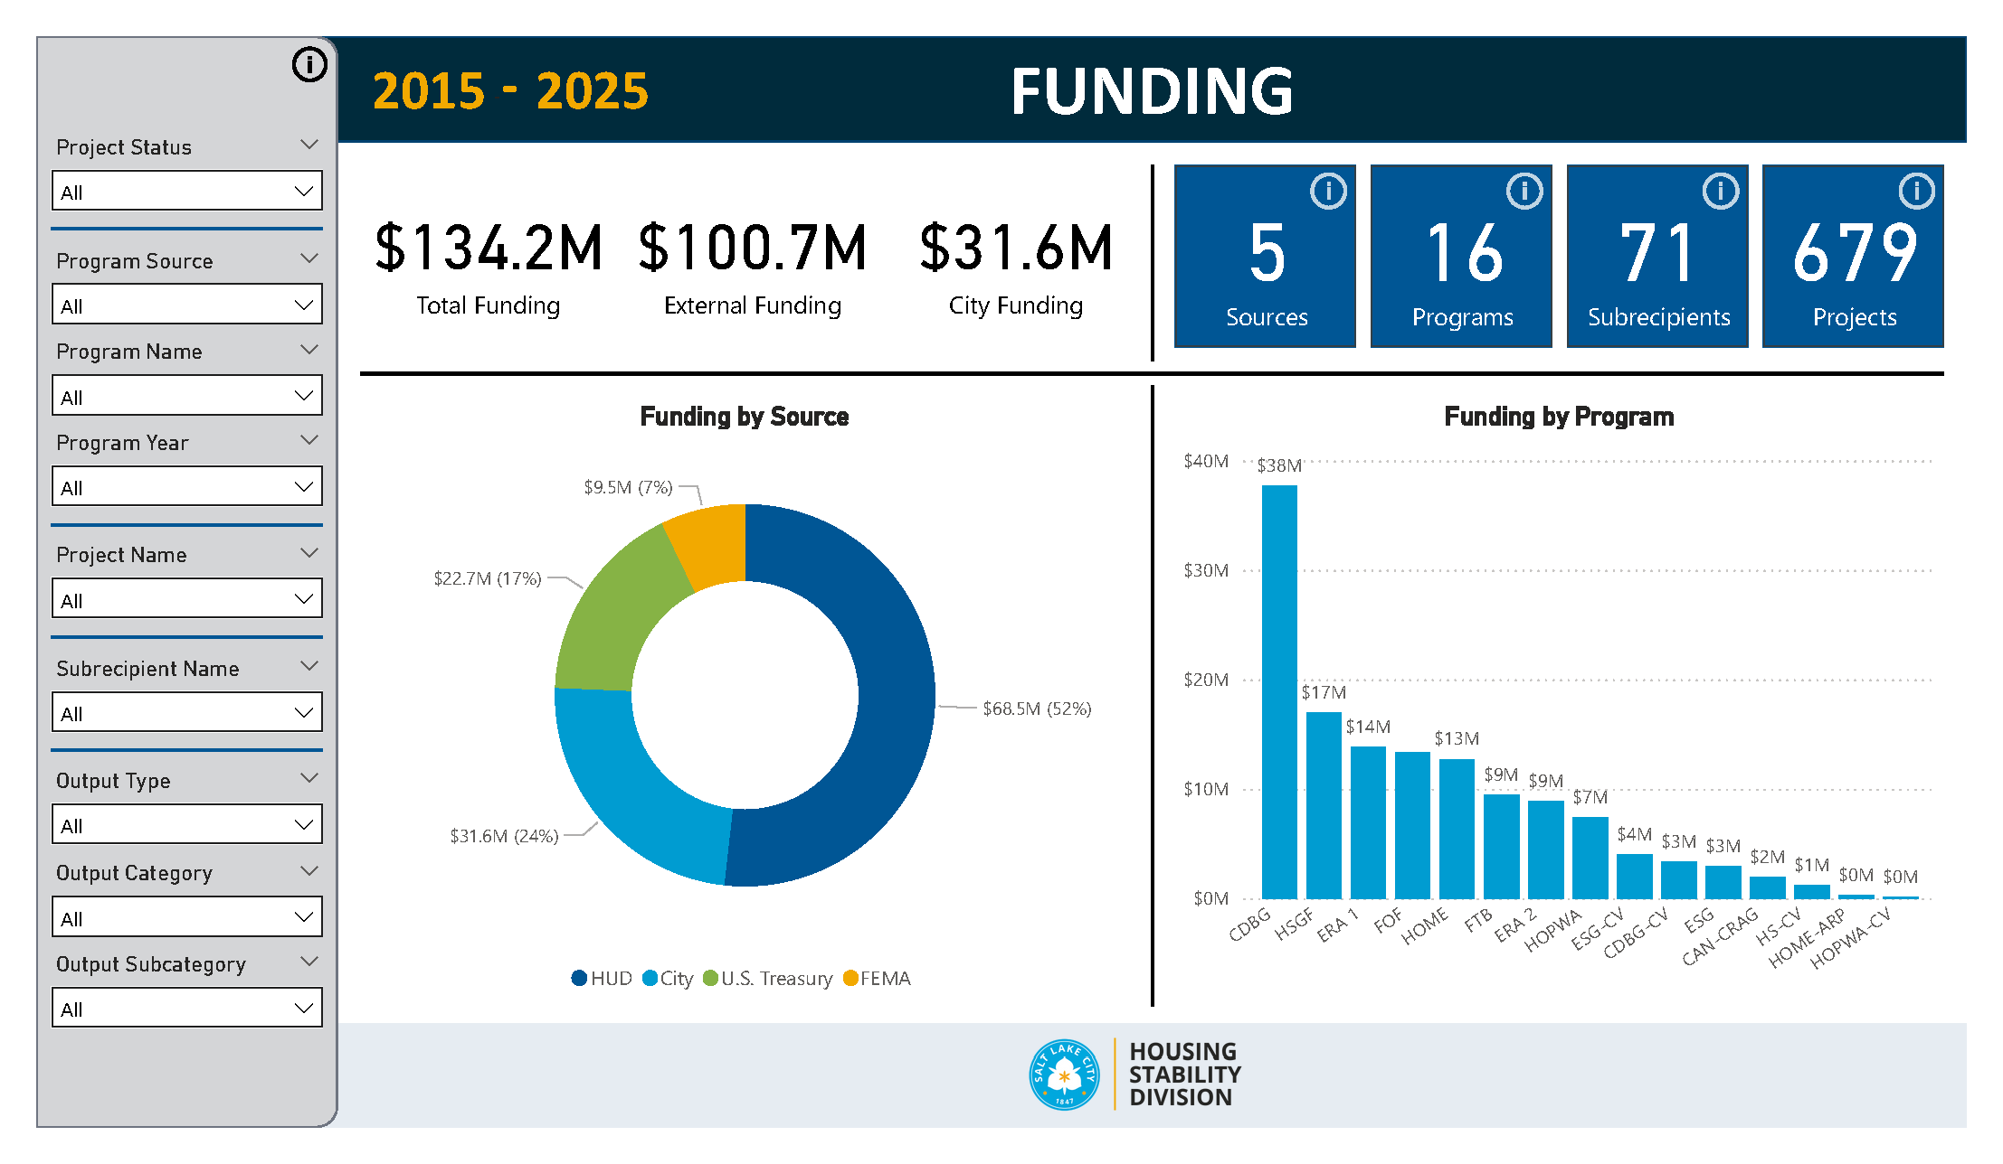

Slide 37
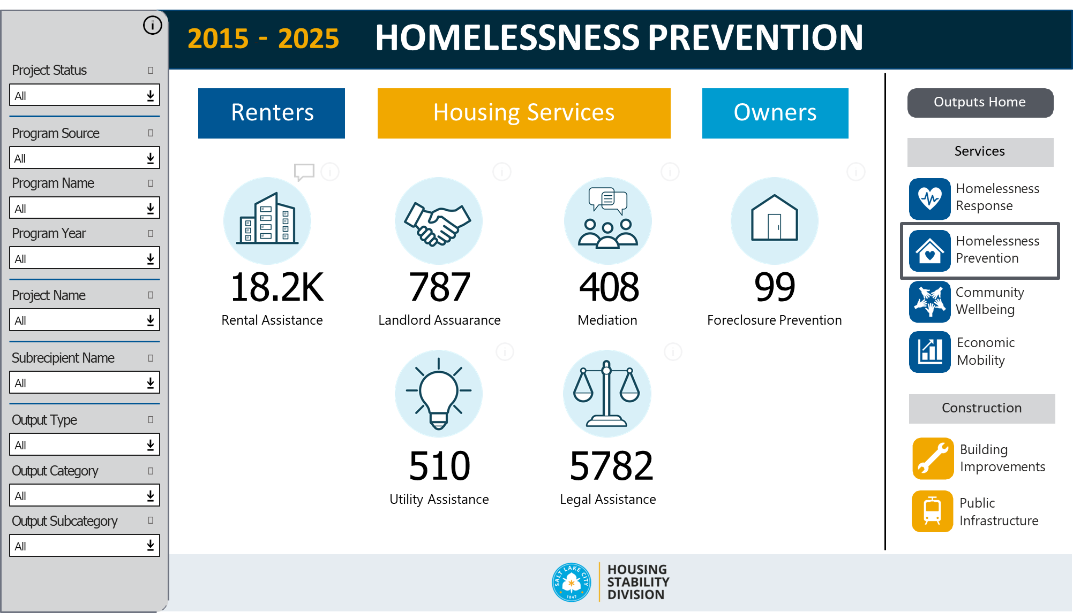

Slide 38
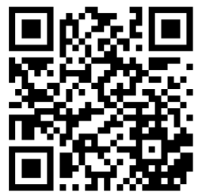
TYLER DURFEE
Policy & Program Manager
tyler.durfee@slc.gov
Salt Lake City
Housing Stability Division
www.slc.gov/housingstability/data/
SEE OUR DATA
FEBRUARY 2026 NCDA CONFERENCE

